Slide 1

Care About Your Craft
adventures in the art of software development
Notes:
Intro
Who am I?
Why am I here?
How long have I been doing this?

Slide 2



Notes:
Professionally, I work for Quick Solutions, even though none of these people do.
Been with Quick for four years, all in the App Dev Group started by BHP.
Been developing for over 10 years, all in Columbus.

Slide 3

Notes:
Love hockey, especially this guy…pay a lot to see him, at least.

Slide 4

Notes:
Ask Why.
Why should I use this software?
Why should I use this language?
Why this framework?
Why do users do it this way?

Slide 5

everything is a people problem
Notes:
Everything is a people problem.
Work with users as close as you can. Provide them options if possible.
Work with colleagues.
Damage control when the time comes – have a solution.

Slide 6

you don’t know better than the users
Notes:
You don’t know more than the users.
“You don’t know what you want, Luigi knows what you want.”
You don’t know the process better than the users.
Provide value where you can improve their process…ask, “Why?”
Beware of, “That’s the way it’s always been,” answers. Dig deeper.
Example: Monkey story

Slide 7

communication
Cans with string
Notes:
Communication.
Daily Stand-up
Project Wiki
Email, IM, Twitter
Clear, professional emails with users (5 sentence rule)
Example: Aaron saying, “Oh, we’ve done that already,” after I solved a difficult problem on M1
Notify teammates of refactorings.

Slide 8


justify tech use
Notes:
Justify tech use.
TFS v. Subversion
Critically analyze any technology/framework/language – (Microsoft “sheep” issue)
Example: “Vote of no confidence” on EF
Don’t use new just because it’s new
→ Move to “design”

Slide 9

design by contract
Notes:
Design By Contract.
Use interfaces
Method requirements in parameters, exception if they’re incorrect
Crash Early

Slide 10
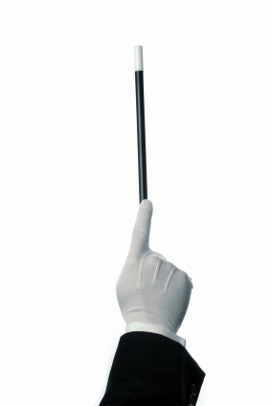
don’t program by coincidence
Notes:
Don’t Program by Coincidence
Test, test, test
Prove your design
Example: FU professor bringing down 800 service at at&t
Example: Trial and error…first two trials work, but when error shows up you don’t know why because you never understood how it worked in the first place.

Slide 11

don’t be a plumber
Notes:
Don’t be a plumber
Use frameworks – nHibernate, LINQ to SQL, Ninject, Windsor, MVC

Slide 12
YAGNI
Notes:
You ain’t gonna need it.
Resist adding code that might help in the future.
TDD helps stop this.

Slide 13

Notes:
Keep an eye on the big picture
Feature drift/scope creep
Know what other members of your team are working on (Stand-up, communication)
Explain stand-up meeting: 13 minutes, what you did yesterday, what you’re doing today, what’s holding you up
→ Move on to coding practices

Slide 14

quality
Notes:
Quality.
“At Ford, Quality is Job 1.”
Make quality a requirements issue.
Nobody sets out to write bad code, but bad habits form.
“Everybody else is doing it, man!”

Slide 15

DRY
Notes:
DRY
Don’t Repeat Yourself
Once is initial code, twice is a coincidence, third time is a pattern.
Example: RPS Trailer moving, worked hard not to move the same one twice. Didn’t follow that as much when I got to software.
“Copy, paste, 10 minutes.”
Think about what you’re doing
Orthagonality
Borrowed from geometry, means moving along one line will not change your position on an intersecting line. Such as points on an x/y axis.
Software it means making changes to one part of the system will not effect the others, like changing your db shouldn’t impact the UI
Terms:
Decoupled
Seperation of Concerns
MVC
Business Logic layer adding UI items to a select list. (Putting “Select” in when it’s a UI only option.)
→ Move into Testing

Slide 16

unit testing
Notes:
Unit Testing
TDD/BDD
Red, Green, Refactor
Test one thing per test
Use mocking to get unrelated things out of the way
Write testable code

Slide 17

your users will test your code
Person concentrating at a computer
Notes:
Test your software, your users will
Beyond unit tests
Integration tests
System tests
Performance tests
PP refers to it as “Ruthless testing.”
Example: IBM “Black Team” from Peopleware. – emphasize the culture created here
→ Move to automated processes

Slide 18
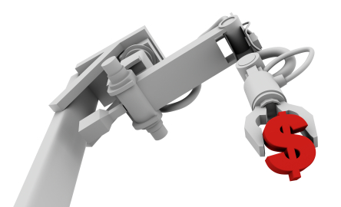
automate
Notes:
Automate.
Automate, don’t do processes manually.
Lots fall into this – code generation, use of source control, start up procedures, macros, etc
Specifically here, Build process
Use continuous integration – TFS, CC.Net, nAnt, msBuild, Team City, etc
Automate the running of your unit tests
Failed unit test == broken build
Don’t live with a broken build
Don’t check in code when the build is broken
Examples:
ThoughtWorks example of client commenting out the tests
Todd’s example of the three month broken build
Our 5 day broken build on VCS

Slide 19

collective ownership
Notes:
Collective Ownership
“It takes a village” theory
Don’t refer to problems as “yours” but rather “ours”
Don’t pull out the blamethrower, don’t be a blameosaurus
Everybody takes responsibility for a broken build.
Stop everything when build breaks
Determine source of break
Breaker should fix the build, or at least be made aware of what broke it. (Communication!)
Example: Josh’s dunce cap example with the lava lamp, our lunch buying example

Slide 20

broken windows
Notes:
Don’t live with broken windows
Refactor them out immediately
Example: CSS on large projects
Example: Get v. Load in nH on M1 which lead to a programmatic catch block

Slide 21

Notes:
Thought about using this for the “Broken Windows” slide.

Slide 22

refactor. refactor. refactor.
Notes:
Refactoring
Refactor early and often
Why do we refactor?
Remove broken windows
Found a better way to do something through new knowledge
Improve performance
You found some wet code
You’ve found some tightly coupled code, non-orthagonal, like the page_load in a web form.

Slide 23
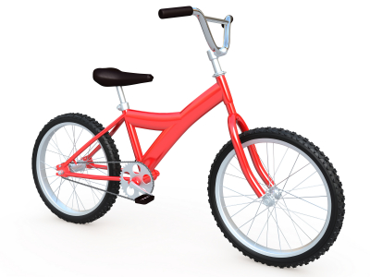
good enough
Picture of Rope Bridge
Notes:
Good Enough.
Know when to say when.
Avoid gold plating, adding value beyond the specs.
Avoid Refactorbation, refactoring code for your own pleasure and no real gain.
You can’t write perfect software.
→ Move into debugging

Slide 24

debugging
Picture of a bug
Notes:
Debugging.
Find bugs once and only once
Wrap with a unit test
Hardest problems first – Finz example of doing low levels first to “get more done.”
Time box difficult problems
Give yourself a reasonable amount of time
Keeps from floundering or spinning of wheels
Keeps momentum going
Rubber Ducking
Second set of eyes, bobbing head “like a rubber duck.”
Explain the problem
Example: Alexei walking into my cube, I thought what I was going to tell him and found the issue

Slide 25

don’t…
Panicking person
Notes:
Don’t panic
Don’t rush
Yes, there’s a problem, rushing through it may create more
Slow down, THINK about the problem
Don’t assume it, prove it
Isolate the code that is causing the bug.
Remove outside code from equation – db isn’t the problem, framework isn’t problem
Example 1: Phil working with Ent Lib, debugger stopped in Ent Lib so he went there rather than into his code that was calling it
Example 2: Finz with the VAB. VAB throwing object error, he was ready to throw his hands up and remove it. Issue was he was passing a null object to it.

Slide 26

fix the problem, not the blame
Notes:
Fix the problem, not the blame
Put away the blamethrower, finding out who did it doesn’t get the issue solved any quicker
Example: PM having me search down who and when an issue was created, took me four hours when the fix only took one.
Provide Solutions, not excuses
Take responsibility for issues
If you find a problem, have a solution before taking it up the ladder
→ Move into continuous improvement

Slide 27


continuous improvement
Notes:
Continuous Improvement
Have a mentor
Learn a new language: my choice is Ruby
Certs, blogs, books, etc.
Know what to unlearn
“That’s the way it’s always been.” – Old habits die hard. (Refer to don’t be a plumber.)
Be a Specializing Generalist - Jim Holmes
No Best Practices, only better practices – we’re hung up on the Best Practices phrase, but they’re constantly evolving

Slide 28

keep your toolbox full
Photo of toolbox
Notes:
Keep your toolbox full.
Know your IDE
Add plug-ins to help productivity (Slick Edit tools, Resharper, Code Rush/Refactor)
Lower your mouse dependency (Move mouse to the other side of the keyboard)
Get to know a good text editor (Notepad2, Notepad ++, E)
Good source control.

Slide 29

attitude
Notes:
Attitude.
5:01 developers – OK, but help them along in their 8 hours
Be a catalyst for change
“Negativity kills ingenuity.” – T. Kaufman butchering a Venkat saying

Slide 30

be a mentor
Notes:
Be a Mentor.
Have a mentor, but also BE a mentor
“Eat like a bird, poop like an elephant” – Guy Kawasaki
Lunch and Learns
Book reviews
Allow people to figure it out. Point them in the right direction, but don’t solve it for them.

Slide 31

create a culture
Notes:
Being a catalyst for change and being a mentor, create a culture
Make TDD, CI, and positive attitudes habits
Adopt the stand-up meeting, even if you’re not full-on agile
Example: “Donuts!”
Reference the IBM Black team again
End

Slide 32
Tim Wingfield
Email: tim@timwingfield.com
Blog: blog.timwingfield.com
Twitter: timwingfield
Code: code.google.com/p/codeincubator/

